Slide 1
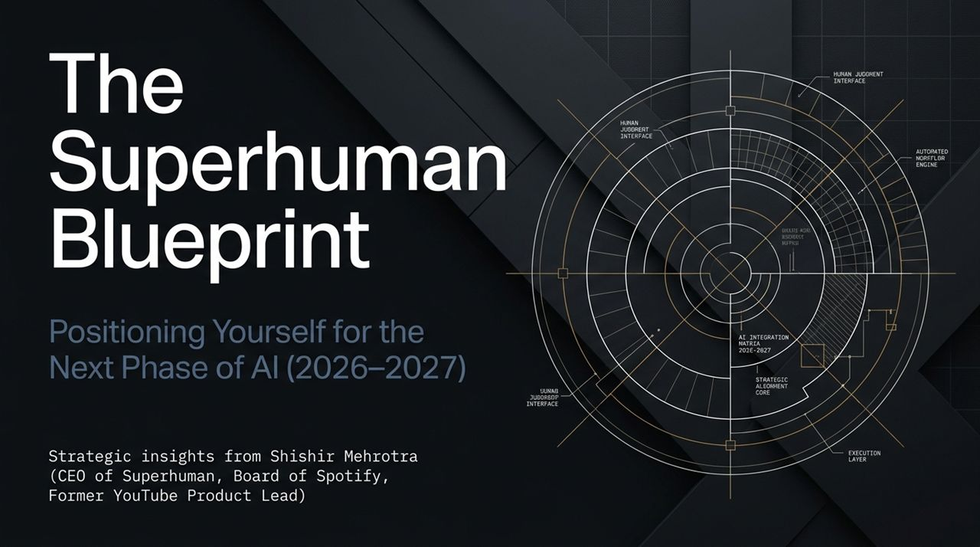
Notes:
Welcome & Introduction:
Good morning/afternoon, everyone. Today, we are discussing how to navigate the rapid evolution of artificial intelligence over the next 12 to 24 months. We aren't just looking at tools—we are looking at strategy, positioning, and how work itself is shifting.
Context & Guest Background:
To anchor our strategy, we reference insights from Shishir Mehrotra. Shishir’s career spans over two decades of defining tech movements: leading product at YouTube during its exponential growth, serving on the board of Spotify for over ten years, founding Coda, and currently serving as CEO of Superhuman (which now incorporates Grammarly).
Thesis Statement:
The central premise of today's talk is simple: Stop practicing prompt engineering, and start cultivating AI judgment and systems architecture. Over the next 16 slides, we will cover how career advancement, team leadership, and product workflows must evolve as execution becomes automated.
https://www.youtube.com/watch?v=JEZVl3BkSLk

Slide 2
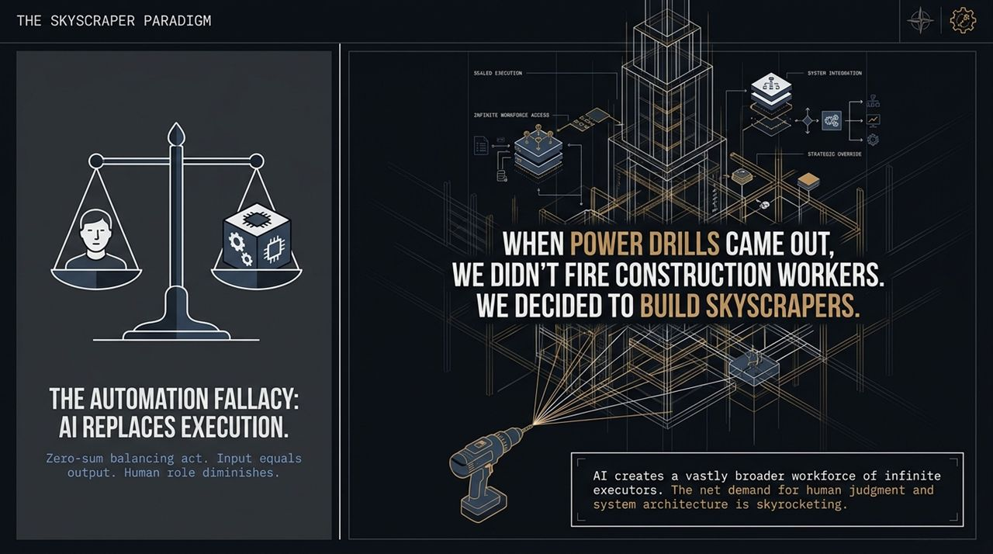
Notes:
The Automation Fallacy:
Whenever new technology arrives, the default narrative is zero-sum automation: 'AI replaces human execution'. People panic thinking, 'If AI writes code, creates graphics, or drafts emails, human roles shrink.'
This stems from viewing work as a fixed bucket of tasks. If the machine takes 80% of the tasks, 80% of the people lose their jobs. But historically, that is rarely how transformational tech plays out.
The Power Drill Analogy:
Shishir uses an analogy: When power drills and modern construction equipment were introduced, did society fire all the construction workers? No. Instead of building 2-story wooden frames, we decided to build 100-story skyscrapers.
Power drills enabled us to scale our ambition. The net demand for construction workers, architects, and structural engineers actually skyrocketed.
Strategic Takeaway:
AI creates an infinite workforce of automated executors. Because execution becomes cheap and abundant, the net demand for human judgment and system architecture rises exponentially.

Slide 3
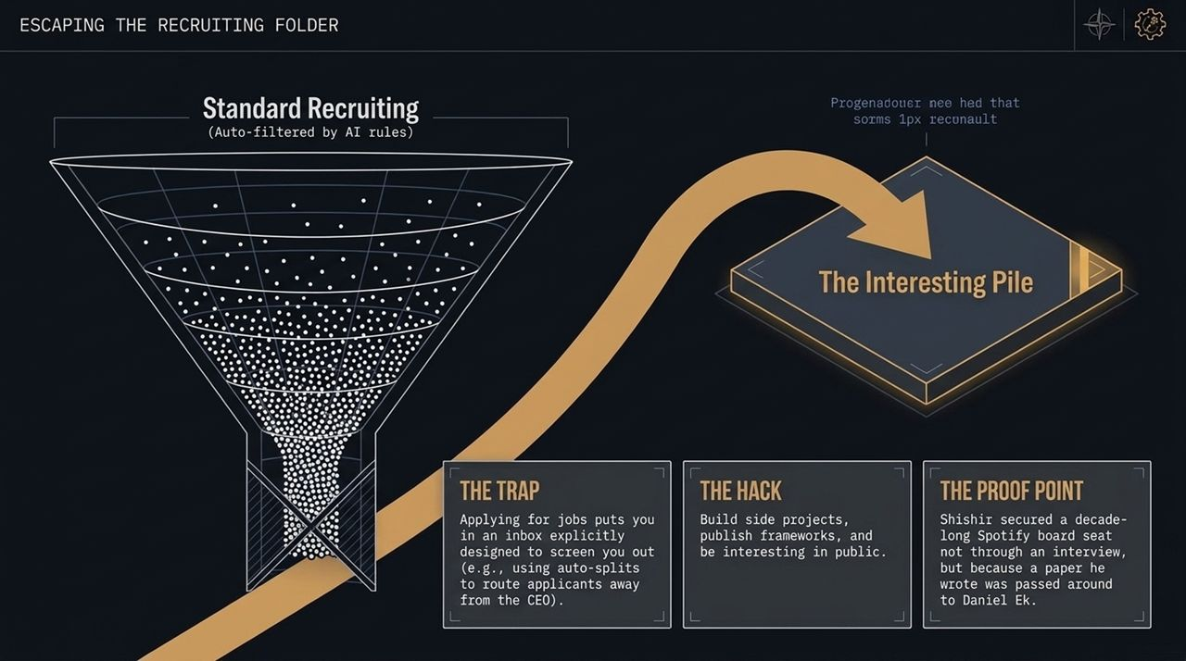
Notes:
The Trap of Standard Funnels:
If you want to position yourself in the AI era, you must first change how you seek opportunities. Applying for jobs through traditional career portals puts you directly into an automated trap.
Executives and hiring managers use automated filters and auto-splits. In fact, Shishir sets up automated email rules in Superhuman specifically to sweep traditional inbound resumes away from his inbox to the recruiting team.
The Hack: 'Be Interesting in Public':
How do you bypass the auto-filter? You don't try to optimize your resume. You build side projects, publish operational frameworks, and demonstrate your thinking publicly.
You want to end up in the 'Interesting Pile'—the personal folder executives check when they want to learn something or talk to smart builders.
The Spotify Proof Point:
Take Shishir’s own experience with Spotify. He didn't interview for a board seat. He wrote a paper titled Formats of Bundling. It was passed around tech circles until it landed on Daniel Ek’s desk. Daniel reached out for a conversation, which evolved into a decade-long board position.

Slide 4
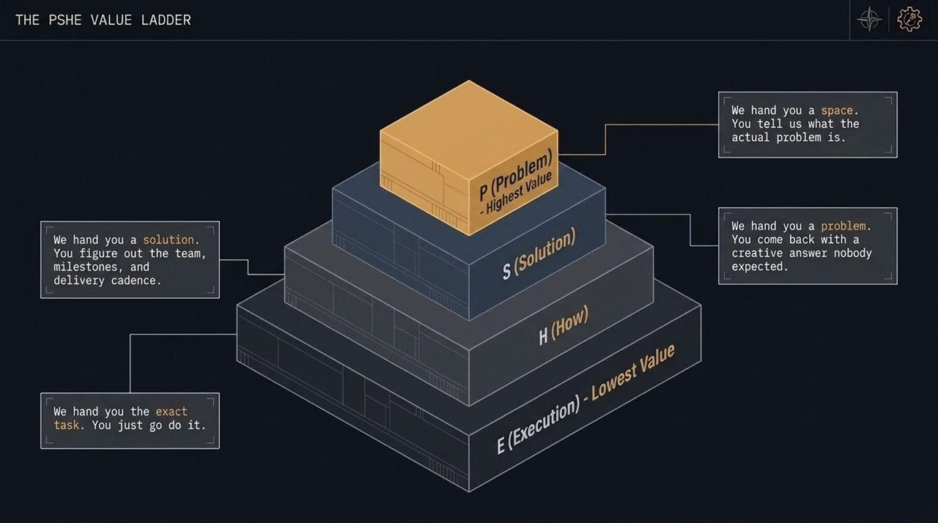
Notes:
Deconstructing the Ladder:
To understand where human value sits today, let's look at the PSHE framework:
E (Execution - Lowest Value): 'We hand you the exact task; you go do it.'
H (How): 'We hand you a solution; you figure out the teams, milestones, and delivery cadence.'
S (Solution): 'We hand you a problem; you bring back a creative answer nobody expected.'
P (Problem - Highest Value): 'We hand you a space; you tell us what the actual problem is.'
The Value Shift:
Historically, young professionals spent their first 5–10 years proving themselves at the E and H levels. But today, LLMs and autonomous agents handle E effortlessly and are rapidly making inroads into H.
Core Realization:
The value anchor has moved straight to the top. If you only execute tasks handed to you, your leverage is near zero. High value comes from accurately identifying the right problem.

Slide 5
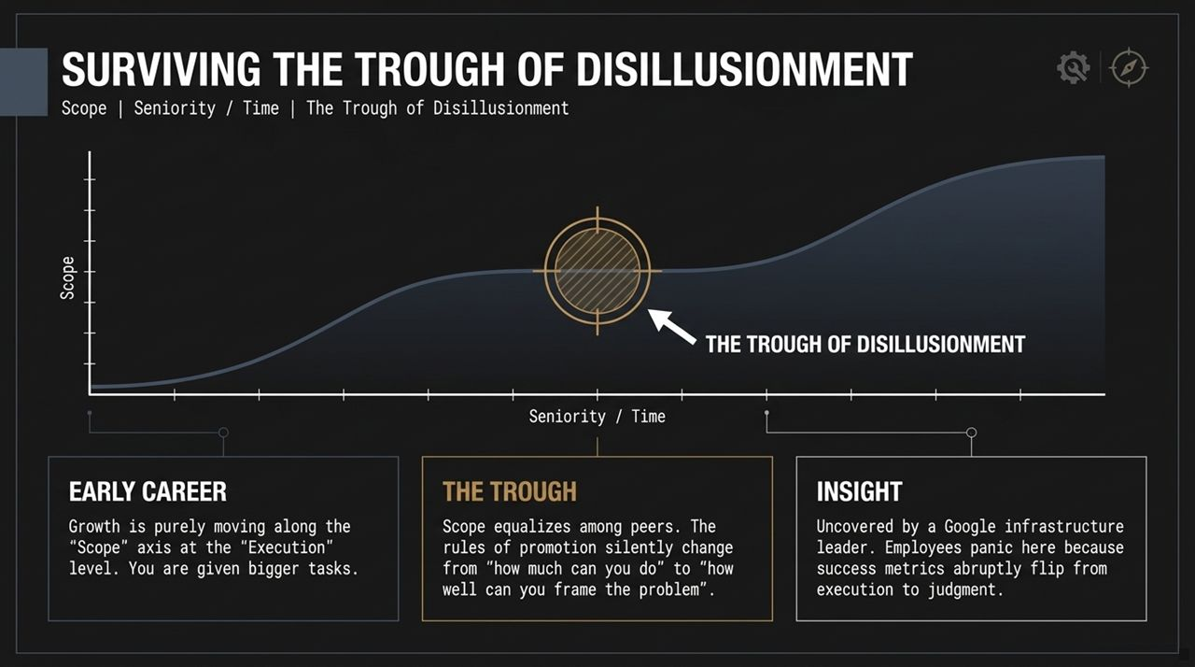
Notes:
Early Career vs. The Plateau:
In early career stages, promotion feels simple: do more work, get bigger tasks. You move linearly along the 'Scope' axis.
Eventually, everyone hits a point where scope equalizes among peers. Suddenly, working longer hours or producing more outputs stops leading to promotions.
The Discovery by Google’s Infrastructure Leader:
A senior leader running Google’s infrastructure mapped her organization across both scope and skill level. She plotted an S-curve and identified a mid-career drop called the 'Trough of Disillusionment'.
Employees panic here because the unwritten rules of promotion flip overnight. Success stops being measured by 'How much volume can you execute?' and shifts to 'How well can you frame the problem?'
Why AI Accelerates This Trough:
Because AI compresses execution timelines, professionals land in this trough much earlier in their careers. You cannot wait until mid-management to develop executive judgment; you need it now.

Slide 6
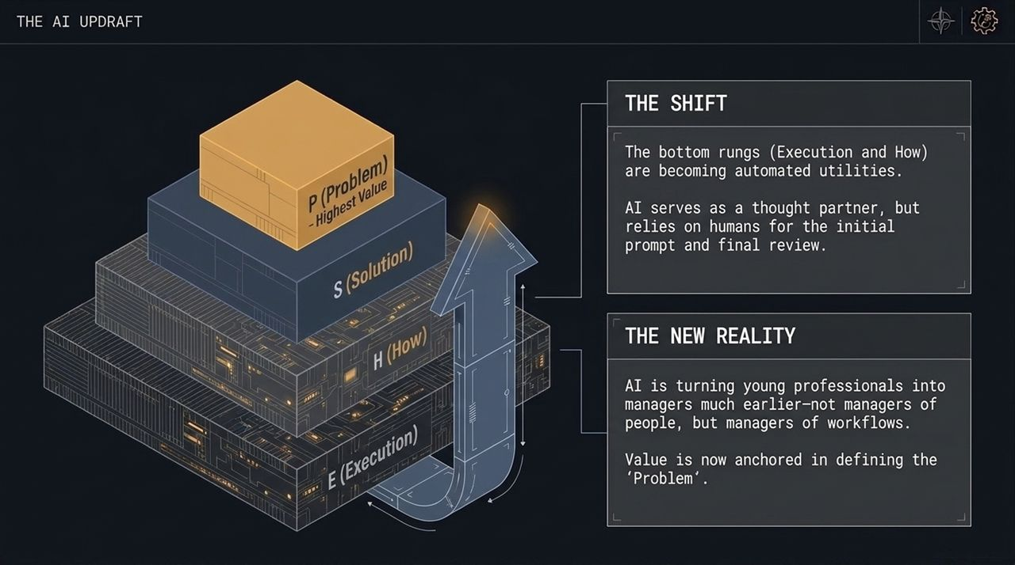
Notes:
The Updraft Effect:
AI acts as a massive thermal updraft. By turning E (Execution) and H (How) into automated utilities, AI pushes workers up the ladder.
Becoming Managers of Workflows:
As Shishir noted, AI turns young professionals into managers much earlier—not necessarily managers of human headcount, but managers of workflows, prompts, and agent networks.
Human-in-the-Loop Judgment:
AI can draft options, but it cannot know what problem matters to your business without human context. Humans provide the initial spark and the final review.

Slide 7
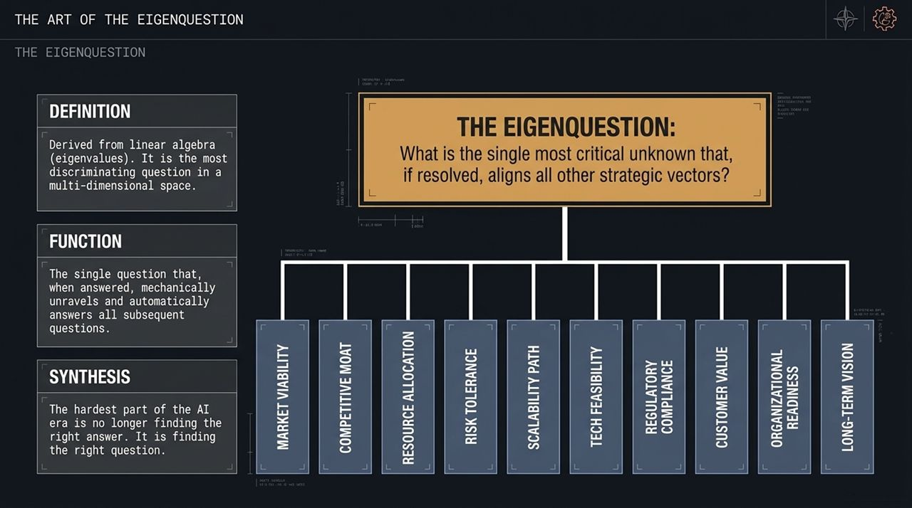
Notes:
Defining the Concept:
How do you systematically practice problem definition? You master the Eigenquestion.
Derived from linear algebra's 'eigenvectors' (the principal vectors in a multi-dimensional space), an Eigenquestion is the most discriminating question in a complex situation.
Functionality:
An Eigenquestion is the single question that, once answered, automatically resolves a cascade of secondary decisions.
In business, people often waste weeks arguing over question #15 on a list, when answering question #1 would make question #15 irrelevant.
The Core Mindset Shift:
Finding answers is no longer the bottleneck—LLMs generate answers in seconds. The scarce skill is formulating the single question that aligns all strategic vectors.

Slide 8
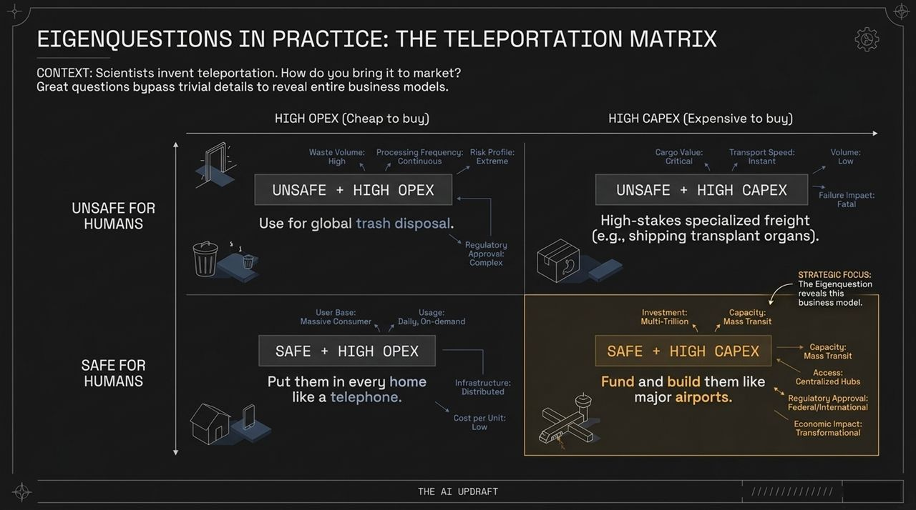
Notes:
The Case Study Setup:
Shishir uses a classic interview exercise: 'Scientists just invented a teleportation device. How do you bring it to market?'
Most people start asking dozens of chaotic details: What color is it? How fast is it? How much does it weigh?
Filtering Down to the Eigenquestions:
Instead of a laundry list, a strong thinker identifies the two core discriminating questions:
Is it safe for humans?
Is the cost structure higher in CapEx or OpEx?
Analyzing the Quadrants:
By mapping these two questions onto a 2x2 matrix, four distinct business models emerge automatically:
Safe + High OpEx (Cheap to buy, expensive to run): Consumer home units placed everywhere like old telephones.
Safe + High CapEx (Expensive infrastructure): Centralized mass transit hubs funded like major international airports.
Unsafe + High CapEx: High-stakes cargo transportation (e.g., organ transplants).
Unsafe + High OpEx: Distributed waste management and trash disposal.
The entire business model resolves once the Eigenquestions are defined.

Slide 9
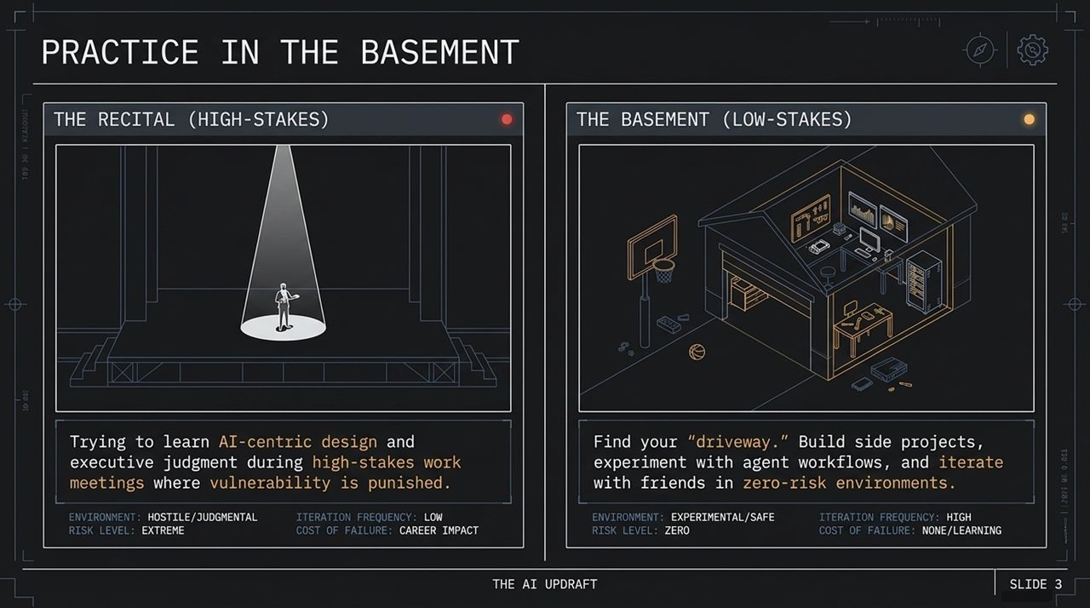
Notes:
The Mistake: Learning in Public:
Where do people try to learn executive judgment and AI design? Usually during high-stakes board meetings or review presentations.
This is like trying to learn the guitar by playing your first notes live on stage at a concert. In a high-stakes environment, vulnerability is penalized, failure carries real career risks, and iteration is slow.
The Basement / Driveway Model:
To master judgment, you need a 'basement' or a 'driveway'—a low-stakes playground with zero risk of failure.
Build side projects with friends, test agent workflows on personal hobbies, or play strategic framework games. Rapid feedback loops in safe environments build intuition.

Slide 10
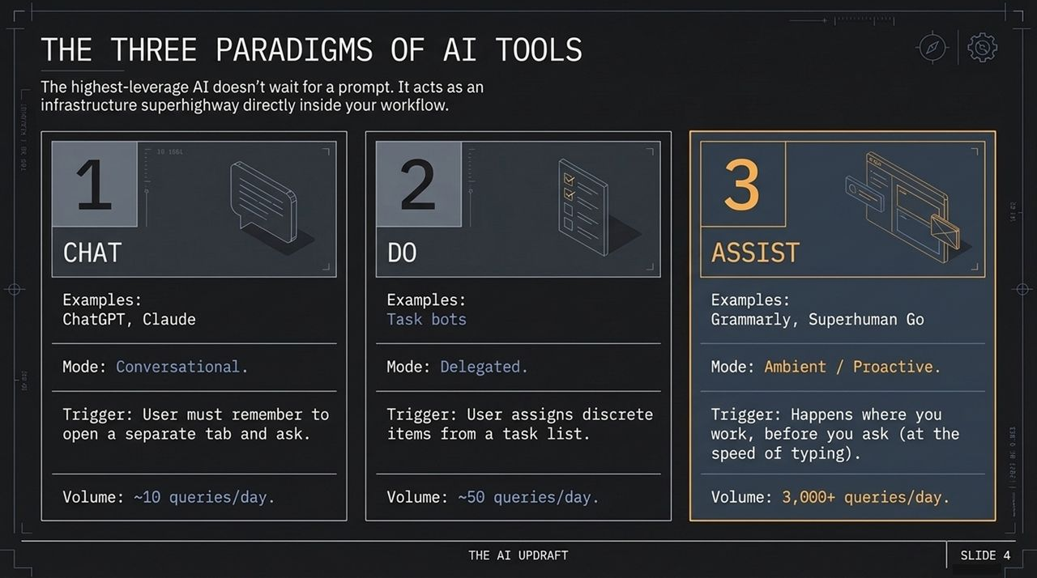
Notes:
1. Chat (Conversational):
Requires opening a separate browser tab and typing a prompt. Friction limits usage to around 10 queries per day.
2. Do (Task-Based):
Discrete task bots where you explicitly assign work items off a checklist. Usage averages ~50 queries per day.
3. Assist (Ambient / Proactive):
Works directly inside your interface at the speed of typing, surfacing insights proactively without waiting for a prompt.
The Leverage Difference:
Grammarly and Superhuman Go operate in this 'Assist' tier, generating over 3,000 LLM queries per user per day because the tool acts as ambient infrastructure rather than a destination.

Slide 11
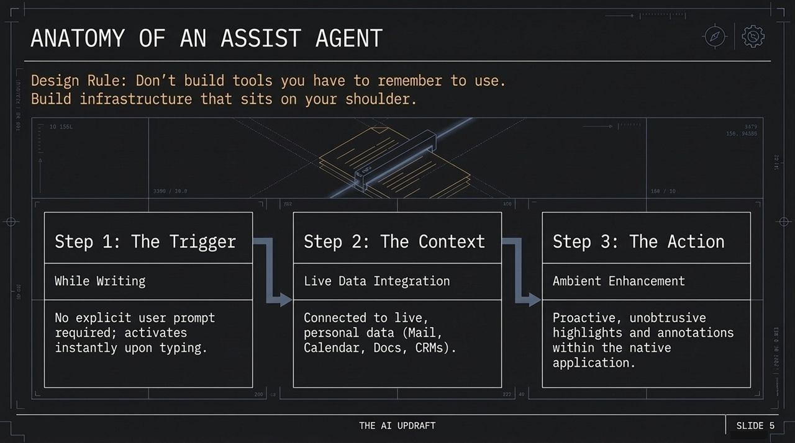
Notes:
Step 1: The Trigger (While Writing):
Eliminates prompt friction. The agent activates continuously as you draft text or review documents.
Step 2: The Context (Live Data Integration):
The agent connects directly to live enterprise data—CRM records, email threads, calendar feeds, and internal wikis.
Step 3: The Action (Ambient Enhancement):
Instead of generating long paragraphs in a side window, it surfaces inline underlines, annotations, or subtle corrections.

Slide 12
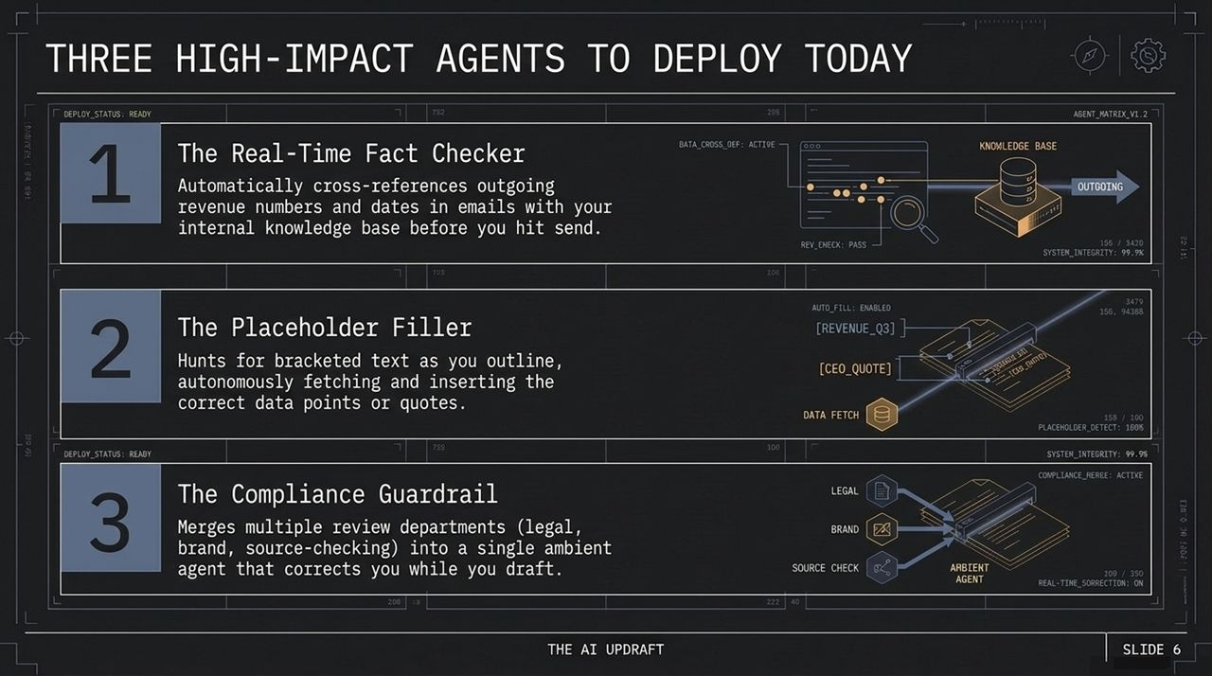
Notes:
1. The Real-Time Fact Checker:
Cross-references outgoing financial numbers or dates against internal databases before you hit send.
2. The Placeholder Filler:
Hunts for bracketed text like [Q3_REVENUE] or [CLIENT_QUOTE] in your outlines, pulling in exact figures automatically.
3. The Compliance Guardrail:
Consolidates legal, brand, and editorial review standards into a single ambient assistant that highlights errors in real time.

Slide 13
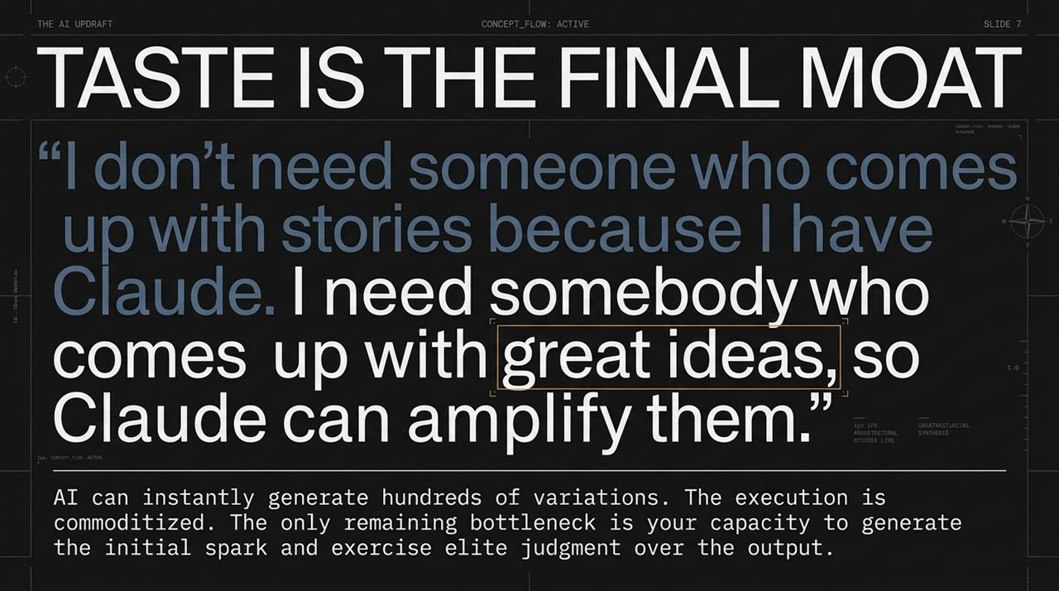
Notes:
Execution is Commoditized:
When anyone can use an LLM to generate dozens of marketing drafts or code snippets, output volume loses its value.
The Value of Taste:
As highlighted in the interview, tools like Claude can amplify ideas, but humans must supply the original spark and curate the results.
Developing refined taste and strict evaluation criteria is the ultimate differentiator.

Slide 14
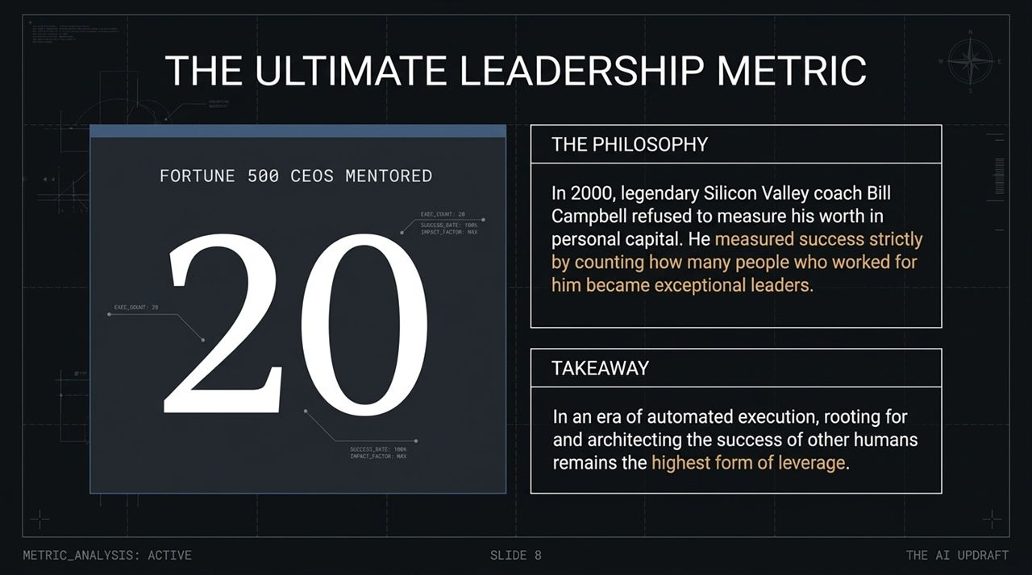
Notes:
Bill Campbell’s Legacy:
Bill Campbell, the legendary Silicon Valley coach, measured his success not by net worth, but by how many people he mentored who went on to become Fortune 500 CEOs.
Leadership in the AI Era:
In an environment where execution is automated, building up and enabling other human leaders remains the highest form of leverage.

Slide 15
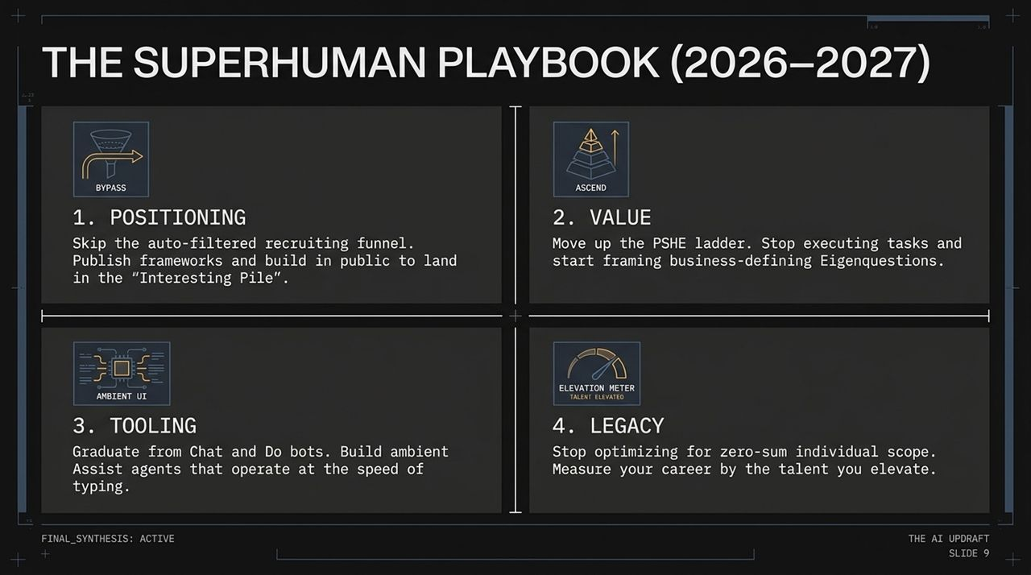
Notes:
1. Bypass: Skip traditional hiring funnels by sharing frameworks and building in public.
2. Ascend: Focus on defining Eigenquestions at the top of the PSHE ladder.
3. Ambient UI: Adopt proactive 'Assist' tools integrated into your daily workflow.
4. Legacy: Measure career growth by the talent and leaders you develop.

Slide 16
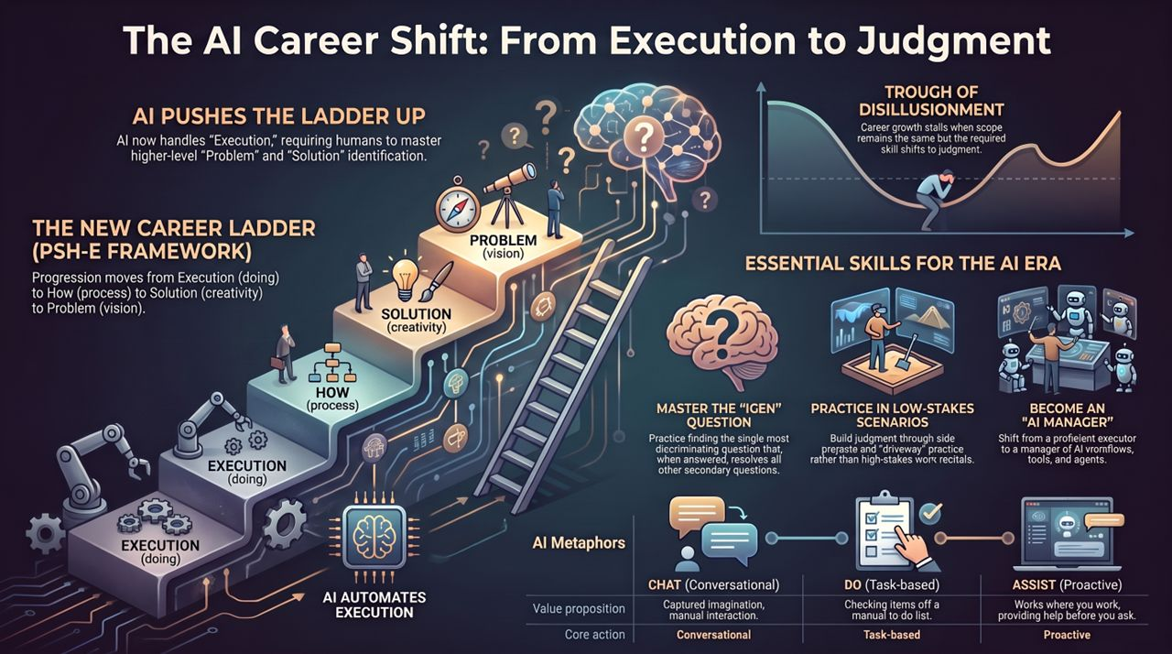
Notes:
Recap of Core Shifts:
To summarize our roadmap:
The Ladder Shift: Moving from execution tasks (E) to problem identification (P).
Tooling Evolution: Transitioning from reactive Chat prompts to proactive Assist infrastructure.
Skill Focus: Mastering Eigenquestions and practicing in low-stakes environments.
Closing Call to Action:
Focus on developing systemic judgment, framing critical business questions, and building workflows that amplify high-value human decisions.

